Slide 1
Introduction to Spark Coursework
The notebook that analyzes the New York City Yellow Taxi dataset using Apache Spark, which is a big data processing engine. The notebook begins by importing necessary libraries and loading the dataset into a Spark DataFrame.
The notebook then performs data preprocessing by filtering out invalid records, converting data types, and creating new columns that will be used in subsequent analyses.
After preprocessing, the notebook answers several research questions related to the dataset, such as the busiest times for taxis, the most popular pickup and drop-off locations, and the relationship between trip distance and fare amount.

Slide 2
TASKS
Analyzing taxi trip data using Apache Spark and Neo4j graph database
Steps:
Data cleaning:
Remove "0 distance" and 'no passengers' records.
Remove outlier records.
Add new columns.
Join with zones dataset.
Compute the unit profitability of each trip.
Zone summarisation and ranking:
Summarise trip data per zone.
Obtain the top 10 ranks according to:
The total trip volume.
Their average profitability.
The total passenger volume.
Record the total and task-specific execution times for each dataset size and format.
Photo by Pexels

Slide 3
Performance Results for Parquet and Delta Formats
Objective: To compare the performance of Parquet and Delta formats in data processing using Spark.
Metrics evaluated: The number of rows processed, execution time, and time taken per million records.
Results:
Delta format outperformed Parquet format in execution time and time taken per million records for all dataset sizes.
For the smallest dataset (S), Delta format executed in 6.75 seconds, while Parquet took 7.68 seconds. Delta also took 3.68 seconds per million records, compared to Parquet's 6.11 seconds.
As dataset size increased, the performance gap widened. For the largest dataset (XXL), Delta format executed in 1.05 minutes, while Parquet took 48.84 minutes. Delta also took 0.475 seconds per million records, compared to Parquet's 22.12 seconds.
Interpretation: The results confirm that Delta format is optimized for query performance and data processing in distributed environments. It leverages features like indexing and caching to improve performance and scalability, making it a more efficient option, especially for large datasets.
Implications: Using Delta format in Spark can significantly improve data processing performance, resulting in faster execution times and lower time taken per million records, compared to Parquet format.

Slide 4
Neo4j Assignment
Task 0: Develop a Cypher query to find nodes and relationships of a specific type.
Task 1 and 2: Execute two different algorithms available in the Neo4j Data Science Library (GDS) to compute the community cluster and centrality score of each node. Both tasks follow the workflow of creating an in-memory graph projection, estimating memory needs (optional), running the algorithm in stats mode to summarise the output, and running the algorithm in stream mode to avoid storing the results in the original graph.
Task 3: Develop a Cypher query that combines the outcomes of tasks 1 and 2 to find the top centrality zones within each community.

Slide 5

Louvain Algorithm
- Used to detect communities in an UNDIRECTED graph weighted by "trips" property in :CONNECTS relationships.
- Runs in stats and stream modes.
- In stats mode, reports number of communities.
- In stream mode, outputs CSV with zone_id and community_id columns.
Photo by Pexels

Slide 6

Page Rank Centrality
- Used to find centrality in a DIRECTED graph.
- Runs in stats and stream modes.
- In stats mode, reports min/max score.
- In stream mode, outputs CSV with zone_id and centrality_score columns.
Photo by Pexels

Slide 7
Analyzing Communities and Centrality in Graphs(Contd..)
In the context of graph analysis, centrality score is a measure of the importance of a node within a graph. Specifically, it measures the node's relative importance or influence within the network based on its connectivity to other nodes. In the PageRank algorithm used in Task 2, centrality score is calculated based on the number and importance of incoming edges to each node. Nodes with high centrality scores are considered to be more influential or important in the network than nodes with low centrality scores. In Task 3, the top three highest centrality zones per each community are being identified, which could suggest important hubs of activity within each community

Slide 8
Analyzing Communities and Centrality in Graphs
In the context of graph analysis, community_id is a label or identifier assigned to a group of nodes that are more densely connected to each other than to nodes outside the group. Community detection algorithms aim to identify these groups, which can represent meaningful clusters or subgraphs within the network. In Task 1, the Louvain algorithm is used to detect communities in the graph, and a community_id is assigned to each node indicating its membership in a particular community. In Task 3, the top three highest centrality zones per each community are being identified, which suggests that community_id can be used as a way to group nodes together and potentially identify important hubs of activity within each community.

Slide 9

Top 3 Centrality Zones
- Finds top 3 centrality zones per community.
- Uses "community" and "centrality" properties.
- Exports to CSV.
Photo by Pexels

Slide 10
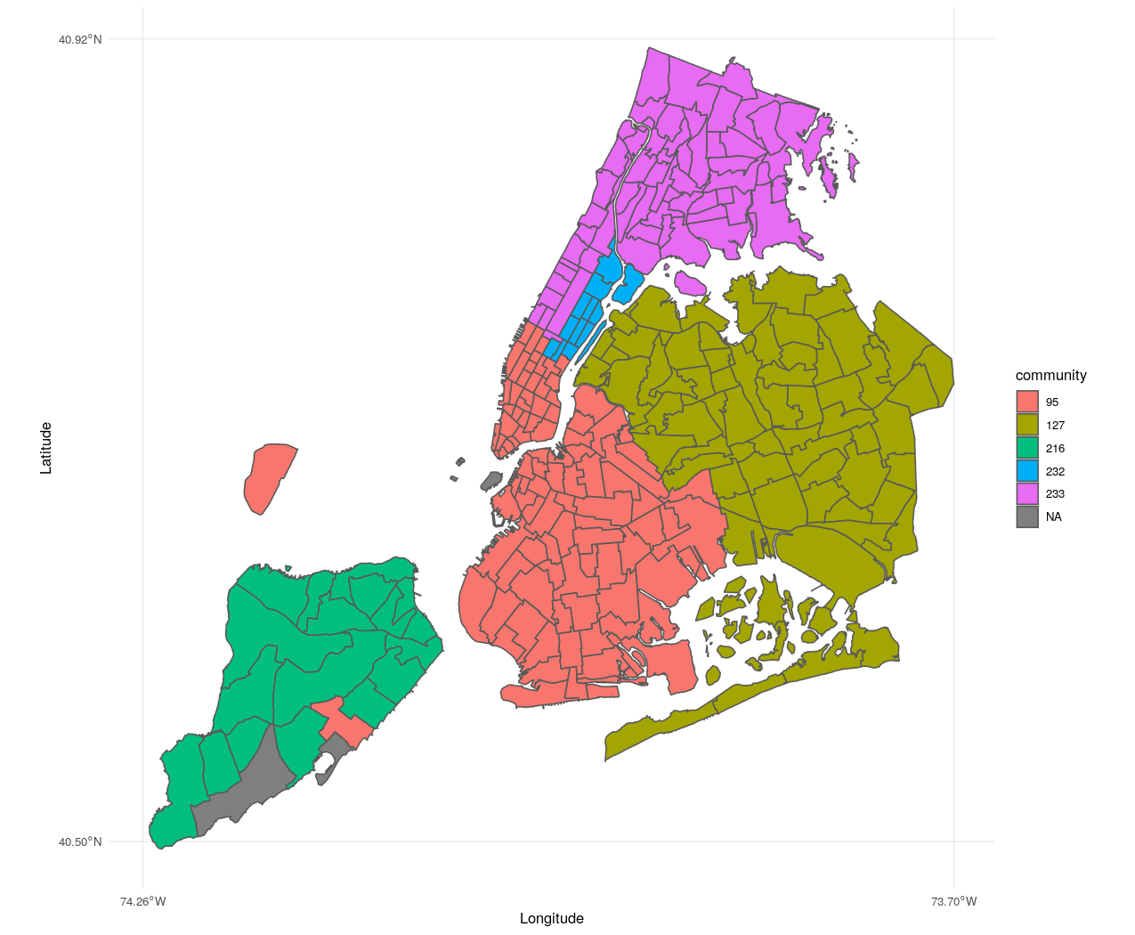
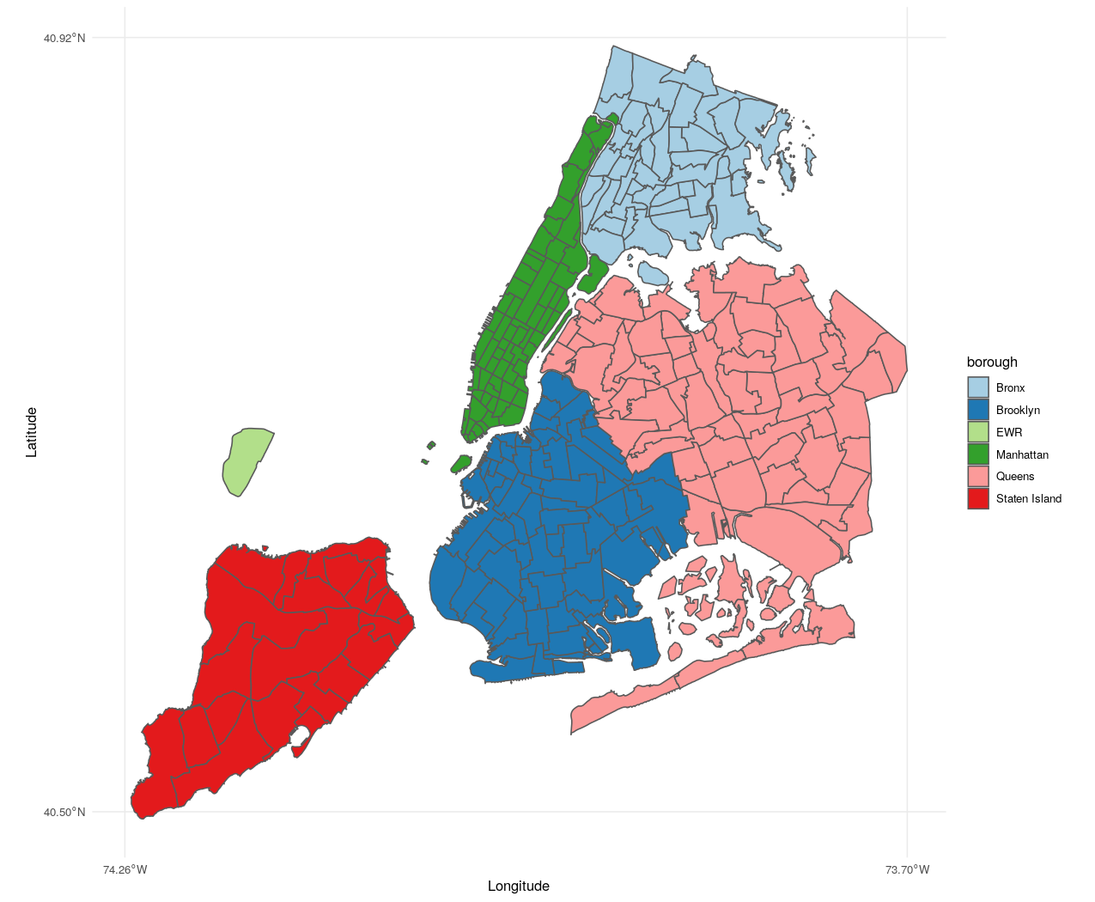
Task 1

Slide 11
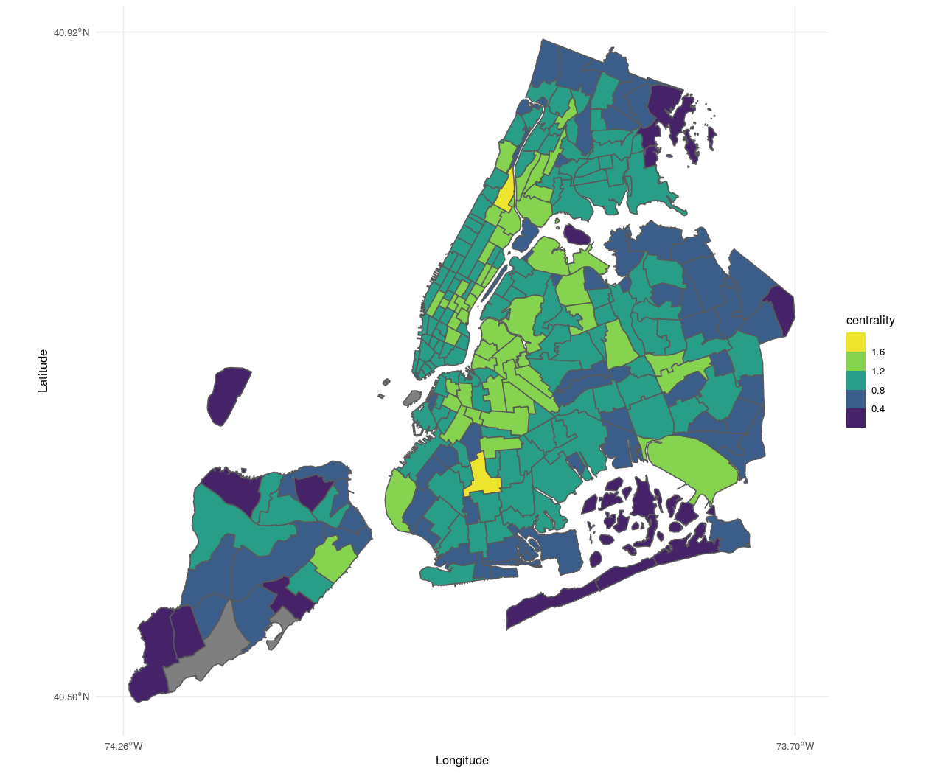
TASK 2

Slide 12
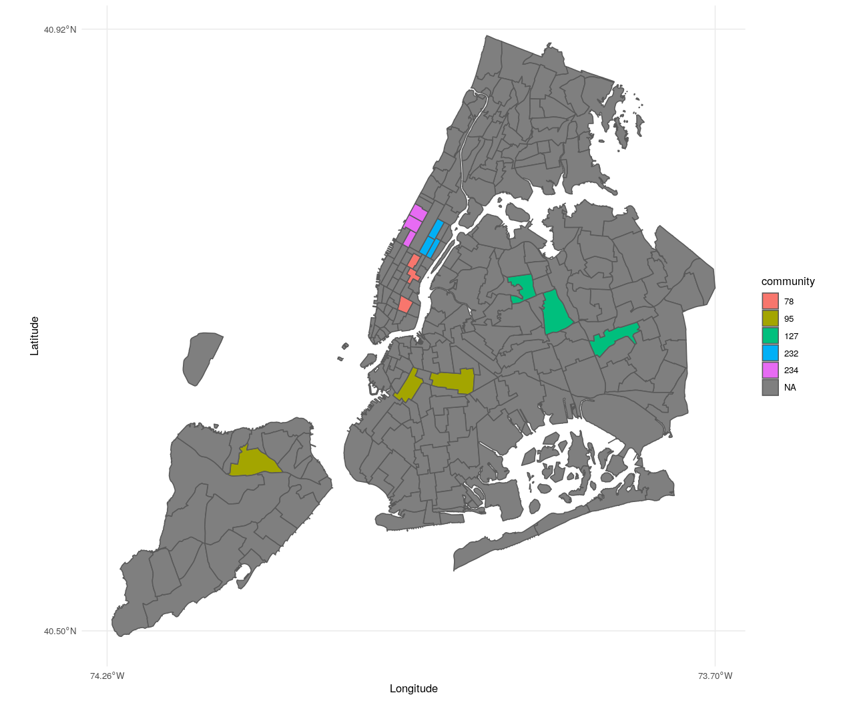
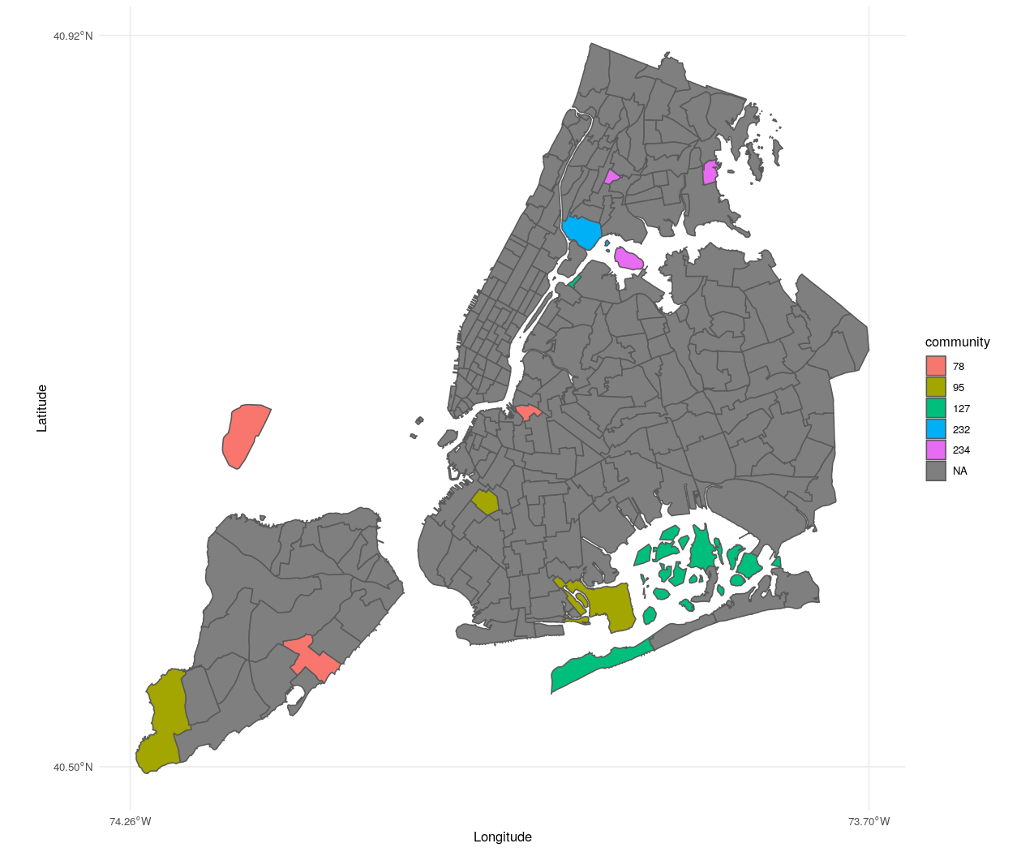
TASK 3a
TASK 3b

Slide 13
Thank you. Please feel free to ask any questions. 😄

